Slide 1
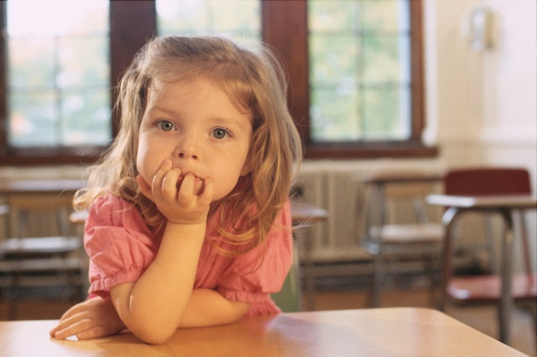
Garrowhill Primary
14th March 2018
Welcome to Primary One

Slide 2
Transitions Principles of transition Nursery to Primary
Acknowledgement that ;
All children are capable learners
Learning in the early years is the basis for future success in learning
Children will learn in different ways and at different rates
Active engagement in a range of experiences based on children’s needs and backgrounds promotes meaningful learning for children
Children construct knowledge based on their own experiences
Communication, consultation, cooperation and collaboration between significant adults is essential in meeting children's’ needs

Slide 3
Curriculum for Excellence
Literacy across the curriculum
Maths across the curriculum
Health & Well Being
Expressive Arts
Social Studies, Science, ICT and Technology
RME
Structured and free play

Slide 4
https://www.youtube.com/watch?v=HQLIm_iwEZM

Slide 5
Belief
Respect
Ambition
Virtue
Equity

Slide 6
School Readiness
Confidence and Resilience
Buddies and New Friends
Independence
Encourage the trying of new ideas
Tidying up and personal care
Dressing
Toilet
Communication
Concentration

Slide 7
Uniform:
grey skirt or trousers, white shirt, school tie or white school polo shirt and school sweatshirt.
PE kit~ shorts, t-shirt and gym shoes.
A pair of indoor shoes must be kept in school at all times
All clothes must be labelled clearly
School Bag
Water Bottle and Healthy snack

Slide 8
School Security Policy
Reviewed as part of on-going assessment of risk to school building users
Janitor is charged with responsibility of providing an adult presence before 9am
HT has responsibility to ensure janitor can fulfil that duty through clear lines of sight on children
No unauthorised adults permitted in school grounds at morning drop off time.
From 8.50am school staff are present at the gates to welcome children to school
Further staff are available in the playground to offer assistance to children should they need it
All doors are alarmed
Playground gates made secure at 9am

Slide 9
Induction Meetings
15th, 16th, May at 1.30pm (P1a, P1b and P2/1)
Children will be taken to their new classroom
Parents will be given information on supporting literacy and numeracy development and school policy on literacy
Opportunity to order school uniform
5th June: all children and parents to meet in hall, children and parents will be shown where to line up and parents to leave children for 45minutes
June 21st Moving Up Day at 1.30pm

Slide 10
We promise not to believe everything your child tells us about you.
Please do the same for us

